Slide 1
A Brief Introduction to
openFrameworks and Unity
CC Lab 2016 openFrameworks Week 1

Slide 2
openFrameworks
openFrameworks is an open source C++ toolkit designed to assist the creative process by providing a simple and intuitive framework for experimentation.

Slide 3


Slide 4
openFrameworks is a well integrated collection of libraries
• OpenGL, GLEW, GLUT, libtess2 and cairo for graphics
• rtAudio, PortAudio, OpenAL and Kiss FFT or FMOD for audio input, output and analysis
• FreeType for fonts
• FreeImage for image saving and loading
• Quicktime, GStreamer and videoInput for video playback and grabbing
• Poco for a variety of utilities
• OpenCV for computer vision
• Assimp for 3D model loading
Look at the range of things you can do with oF!
You don’t have to know these libraries in order to use openFrameworks. The point of using oF is that it provides you with a unified way to use all these functions.
Notes:
Remember what a library is?

Slide 5
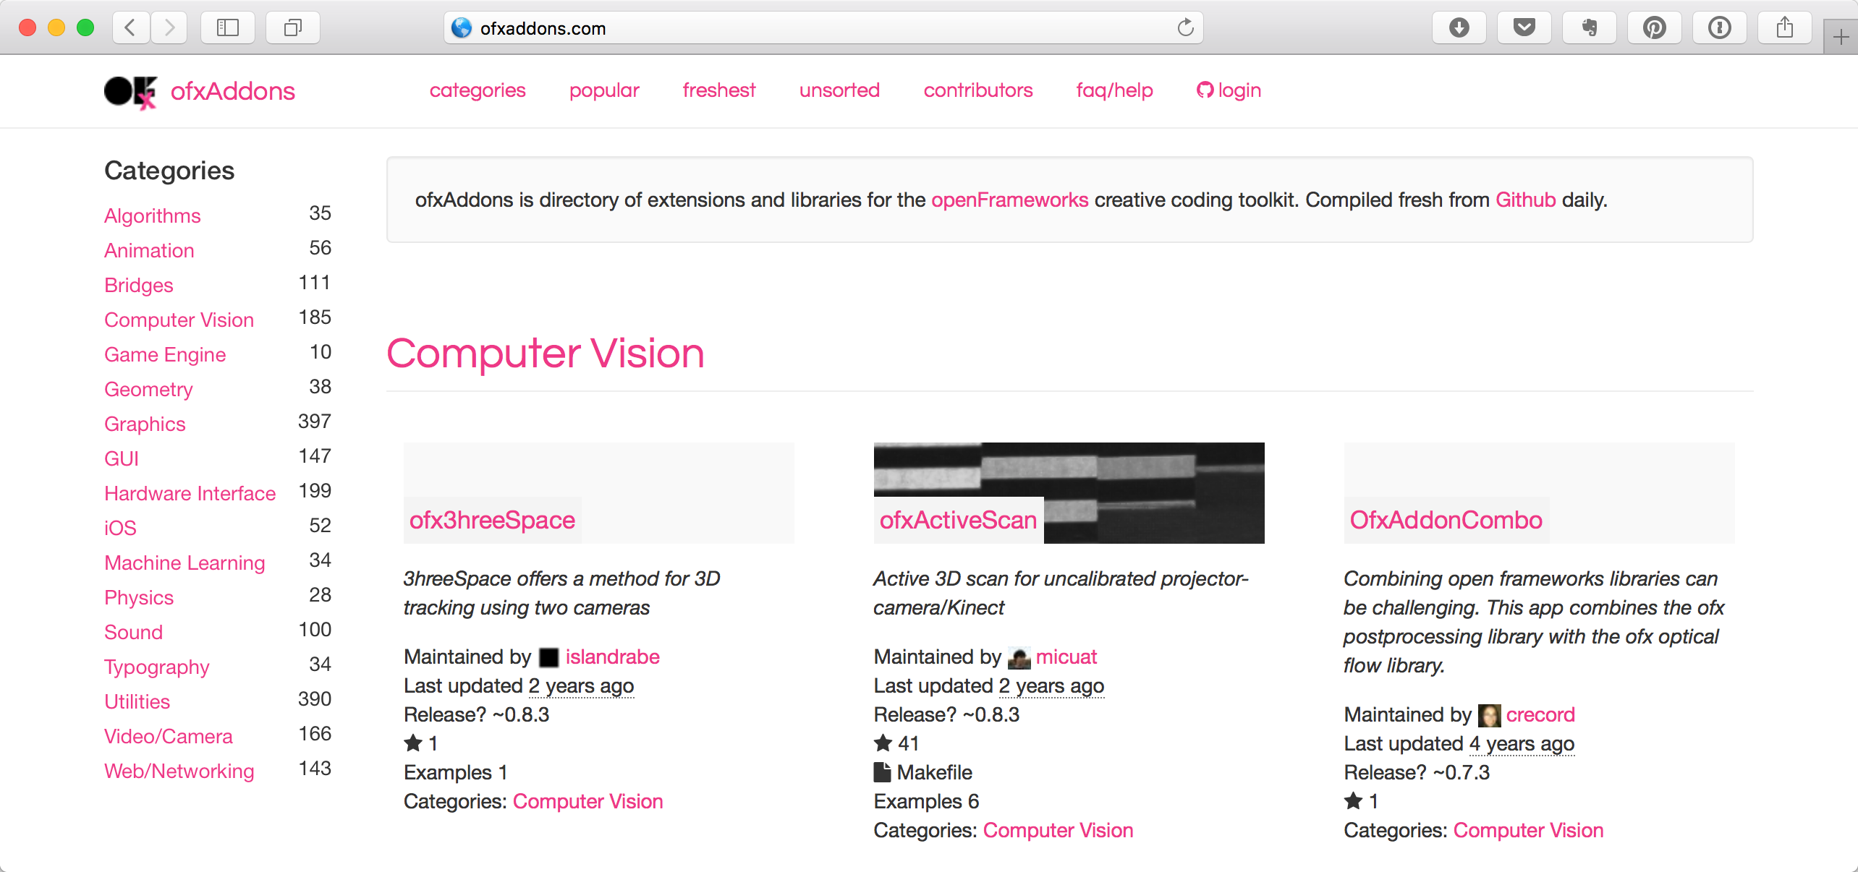
openFrameworks is even enhanced by addons!
Addons are user-developed openFrameworks extensions. They provide popular functions which have not yet been integrated into the core code repo of oF. They may save you a ton of time and efforts.
Notes:
You can contribute to the community when you have implemented some cool function you think other people might be interested to reuse.

Slide 6
openFrameworks is cross-platform
You can use it to develop a desktop app for Mac or PC or a mobile app. Your code even compiles on a Raspberry Pi. This means you can take advantage of what all these platforms offer. It also means you can write openFrameworks code for your interactive installation.
Notes:
Do you recognize all these platforms?
You are going to hide a computer behind your interactive installation anyway, right?

Slide 7
openFrameworks is open source.
openFrameworks is distributed under the MIT License. This gives everyone the freedoms to use openFrameworks in any context: commercial or non-commercial, public or private, open or closed source.
Notes:
While many openFrameworks users give their work back to the community in a similarly free way, there is no obligation to contribute. Open source means you can use them for free!(YAY!) And you are free to contribute to it if you want to further develop or you found a bug. Be sure to give credit if you are using other people code!
There are other open source licenses. They differ in the obligations you have to follow when you use code under that license. For example, GPL License, which Linux kernel is released under, asks you to redistribute your derivative work under the same license term, that is to say, make it open source and free, too.

Slide 8
You develop openFrameworks applications with an IDE
IDE is basically where you write your code and where you debug your app. An IDE normally consists of a source code editor, build automation tools and a debugger. Most modern IDEs have intelligent code completion.
Notes:
Do you recognize these two logos? (Xcode and Visual Studio)
An integrated development environment (IDE) is a software application that provides comprehensive facilities to computer programmers for software development.
Now you may realize that Processing and Arduino also provide you their nice and little IDEs (although very basic).

Slide 9
On a Mac you use Xcode to develop oF applications.
Notes:
Xcode is an integrated development environment (IDE) containing a suite of software development tools developed by Apple.
You also use it to develop applications for Mac, iPhone and iPad, Apple Watch, and Apple TV.

Slide 10
On a PC you use Visual Studio to develop oF applications.
Notes:
Microsoft Visual Studio is an integrated development environment (IDE) from Microsoft. It is used to develop computer programs for Microsoft Windows, as well as web sites, web applications and web services. Visual Studio uses Microsoft software development platforms such as Windows API, Windows Forms, Windows Presentation Foundation, Windows Store and Microsoft Silverlight. It can produce both native code and managed code.
- Oh I don’t use MacOS or Windows! (I use Linux.)
- Fancy! You can use QT Creator or Eclipse.
- Which one is better?
- Xcode is easy to start. But you should know and learn to use both of them.

Slide 11
C++ Programming Language
openFrameworks is written in C++, and you write your oF applications in C++. C++ is a general-purpose programming language. It is object-oriented, that means it is designed for the development of modern and large-scale applications. It also provides facilities for low-level memory manipulation, that means when well written, C++ code is powerful and efficient.
Notes:
And when badly written, C++ code is buggy and dangerous. C++ is infamous for its steep learning curve. Luckily, we’ve already learned a few programming languages which has similar grammars to C++. We’ve learned JavaScript. We’ve learned Java when we learn Processing. The Arduino code we’ve written is actually based on C/C++ grammar, too.

Slide 12
high-level tool
basic
intuitive
low-level tool
powerful
hard to learn
Comparing creative coding environments…
Notes:
P5.js, Processing, openFrameworks, Cinder, openGL

Slide 13

Notes:
openFrameworks sits in the middle—powerful enough to do many cool things, but not too hard to get start with—a pur-fect tool for learning creative coding.

Slide 14
Next steps: what if I like openFrameworks?
Creative Coding: openFrameworks
Currents: Developing Interactive Installations with Cinder
Notes:
Better question: what if I like creative coding?
Relative courses to explore after CC Lab. Registration for Spring 2017 starts Nov 7.
Cinder is a popular creative coding toolkit in industry.

Slide 15
Mac users: feel free to upgrade to macOS Sierra and Xcode 8! (And we encourage you to do so!)
Mac users: feel free to upgrade to macOS Sierra and Xcode 8! (And we encourage you to do so!)
Notes:
One more thing about openFrameworks: we can now compile openFrameworks 0.9.4 Release Candidate under the newest operating system without problem.

Slide 16
Unity is a game engine. You can create any 2D or 3D game with Unity. You can make it with ease, you can make it highly-optimized and beautiful, and you can deploy it with a click to more platforms (including VR headsets!) than you have fingers and toes.

Slide 17

Notes:
It is hard to find good showreel videos to show you those kinds of coooool things we create using Unity in DT, so we have to go back to the thesis projects of MFA Design and Technology, Parsons School of Design, year 2016.
http://mfadt.parsons.edu/2016/
Apparently, you can also find many many cool cool openFrameworks projects on that website, too. Dig into it for your inspirations!

Slide 18
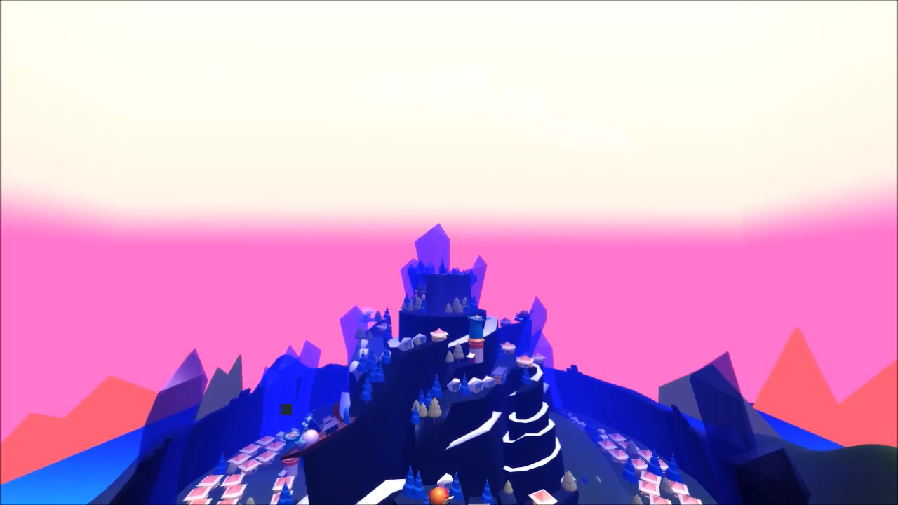
Notes:
Game example: Dawn by Hanyang Jiang, Bo Pu, Victoria Yen, and Yihan Zhou.

Slide 19

Notes:
VR example: Touch Heart by Yunqi Zhou.

Slide 20
You also use an IDE to develop Unity games/applications.
Notes:
You use the same Unity development environment under Mac OS and Windows. Unity is intuitive to use. You use mouse clicks and drag-and-drops to do the majority of your work.

Slide 21
C# Programming Language
You still have to write some code in order to implement your game logic. You’ll write your code in C#, which is a programming language similar but simpler than C++.
Notes:
Note that C# is actually “C++++”. There are four “+” in a “#”.

Slide 22
Next steps: what if I like Unity?
Building Worlds
Recursive Reality
Notes:
Both courses are taught by Robert Yang.

Slide 23
Homework (optional): Download, and try to install openFrameworks!
Mac users:
Download of_v0.9.4_RC1_osx_release.zip at http://openframeworks.cc/versions/v0.9.4_RC1/.
Follow the Xcode Setup Guide at http://openframeworks.cc/setup/xcode/.
Windows users:
Download openFrameworks for Visual Studio (2015) at http://openframeworks.cc/download/.
Follow the Visual Studio Setup Guide at http://openframeworks.cc/setup/vs/.
Notes:
We will cover this in the beginning of next class. But you are encouraged to try it yourself!

